Slide 1

NADA Update:
Safeguards Rule – Overview and Update
Brad Miller
Chief Regulatory Counsel, Digital Affairs and Privacy NADA bmiller@nada.org

Slide 2
Legal Disclaimer – Not Legal Advice

Slide 3
Amended
Safeguards Rule

Slide 4
Amended Safeguards Rule: The “Basics”
1 | 2 | 3 | 4
Abandon “reasonable” standard for the list of requirements | Must comply by June 9, 2023 | Certain requirements do not apply if <5,000 customer records | Increased obligations internal systems and re Third Parties

Slide 5
New Requirements
Qualified Individual | Written Risk Assessment | Access Controls | Data and Systems Inventory
Data Encryption | Secure Development Practices | Multi-Factor Authentication | Systems Monitoring and Logging
Secure Data Disposal Procedures | Change Management Procedures | Unauthorized Activity Monitoring | Intrusion Detection Vulnerability Testing
Overseeing/Monitoring Service Providers | Written Incident Response Plan | Annual Reporting to Board

Slide 6

Updated NADA Driven Guide
www.nada.org/safeguardsrule
Addresses each of the requirements in detail
Includes input from IT specialists
Includes appendices and exhibits
  Sample written policies
  Governmental resources
  NADA Affinity Partner outsourcing resources
  And more

Slide 7
Implementation Challenges
To what data does the Rule apply?
Vendors/OEMs - Agreement to contract language
What must contract say?
Can be complicated, need to determine
  Scope of data shared
  Current contractual language
  Distinction between GLB and Section 5 contract terms

Slide 8
Regulatory Issues
”Section 5”
FTC generally considers any personally identifying information as requiring protection
Outside of GLB – majority of data security actions
Our view —treat all personal data information as NPPI
Difficult to understand/accept
  Beginning to change
What does this mean for dealer compliance?

Slide 9
Dealer Obligations re: Third Parties
If any third party “touches” any consumer information in the custody or control of a dealer
Then dealer has obligations re: that Third Party
If NOT NPI – Section 5 still requires contractual and practical data security measures
If NPI – service provider obligations apply, Dealer must:
Exercise due diligence in selecting
Ensure contract contains required language
Periodically assess the service providers

Slide 10
Compliance “Triage” - Steps to Consider
If you are behind the ball, best steps to take now are to avoid “being hacked” / a data breach
  Training
  MFA
  Encryption – email and device hard drives
  Conduct a penetration and vulnerability test
  Implement your program
    Four written documents are key!

Slide 11
Six Steps to Compliance With the Amended Rule
Designate a “Qualified” Individual
Prepare written documents
Enact technical IT requirements
Enact internal IT procedures
Employee training
Oversee service providers

Slide 12
Safeguards Rule: NADA Resources
www.nada.org/safeguardsrule
NADA Driven Guide
  Templates (including WORD versions)
  Links
  Resources
Webinars
  NADA and Third Party
Workshops
Third party service providers
  NADA Affinity Provider Program | NADA

Slide 13
Safeguards Rule: Next Steps
NADA continues to seek more specific FTC guidance re third party service providers
Ongoing efforts/updates
  E.g., CISA KVA database - Known Exploited Vulnerabilities Catalog | CISA
NADA will continue to work on
  Industry data standards
  Industry data audit standards
FTC next steps?
  Unclear, but expect broad action (hopefully not dealers)
  Enforcement Sweeps?
    One year after original rule went into effect
      https://www.ftc.gov/news-events/news/press-releases/2004/11/ftc-enforces-gramm-leach-bliley-acts-safeguards-rule-against-mortgage-companies

Slide 14
State
Update

Slide 15
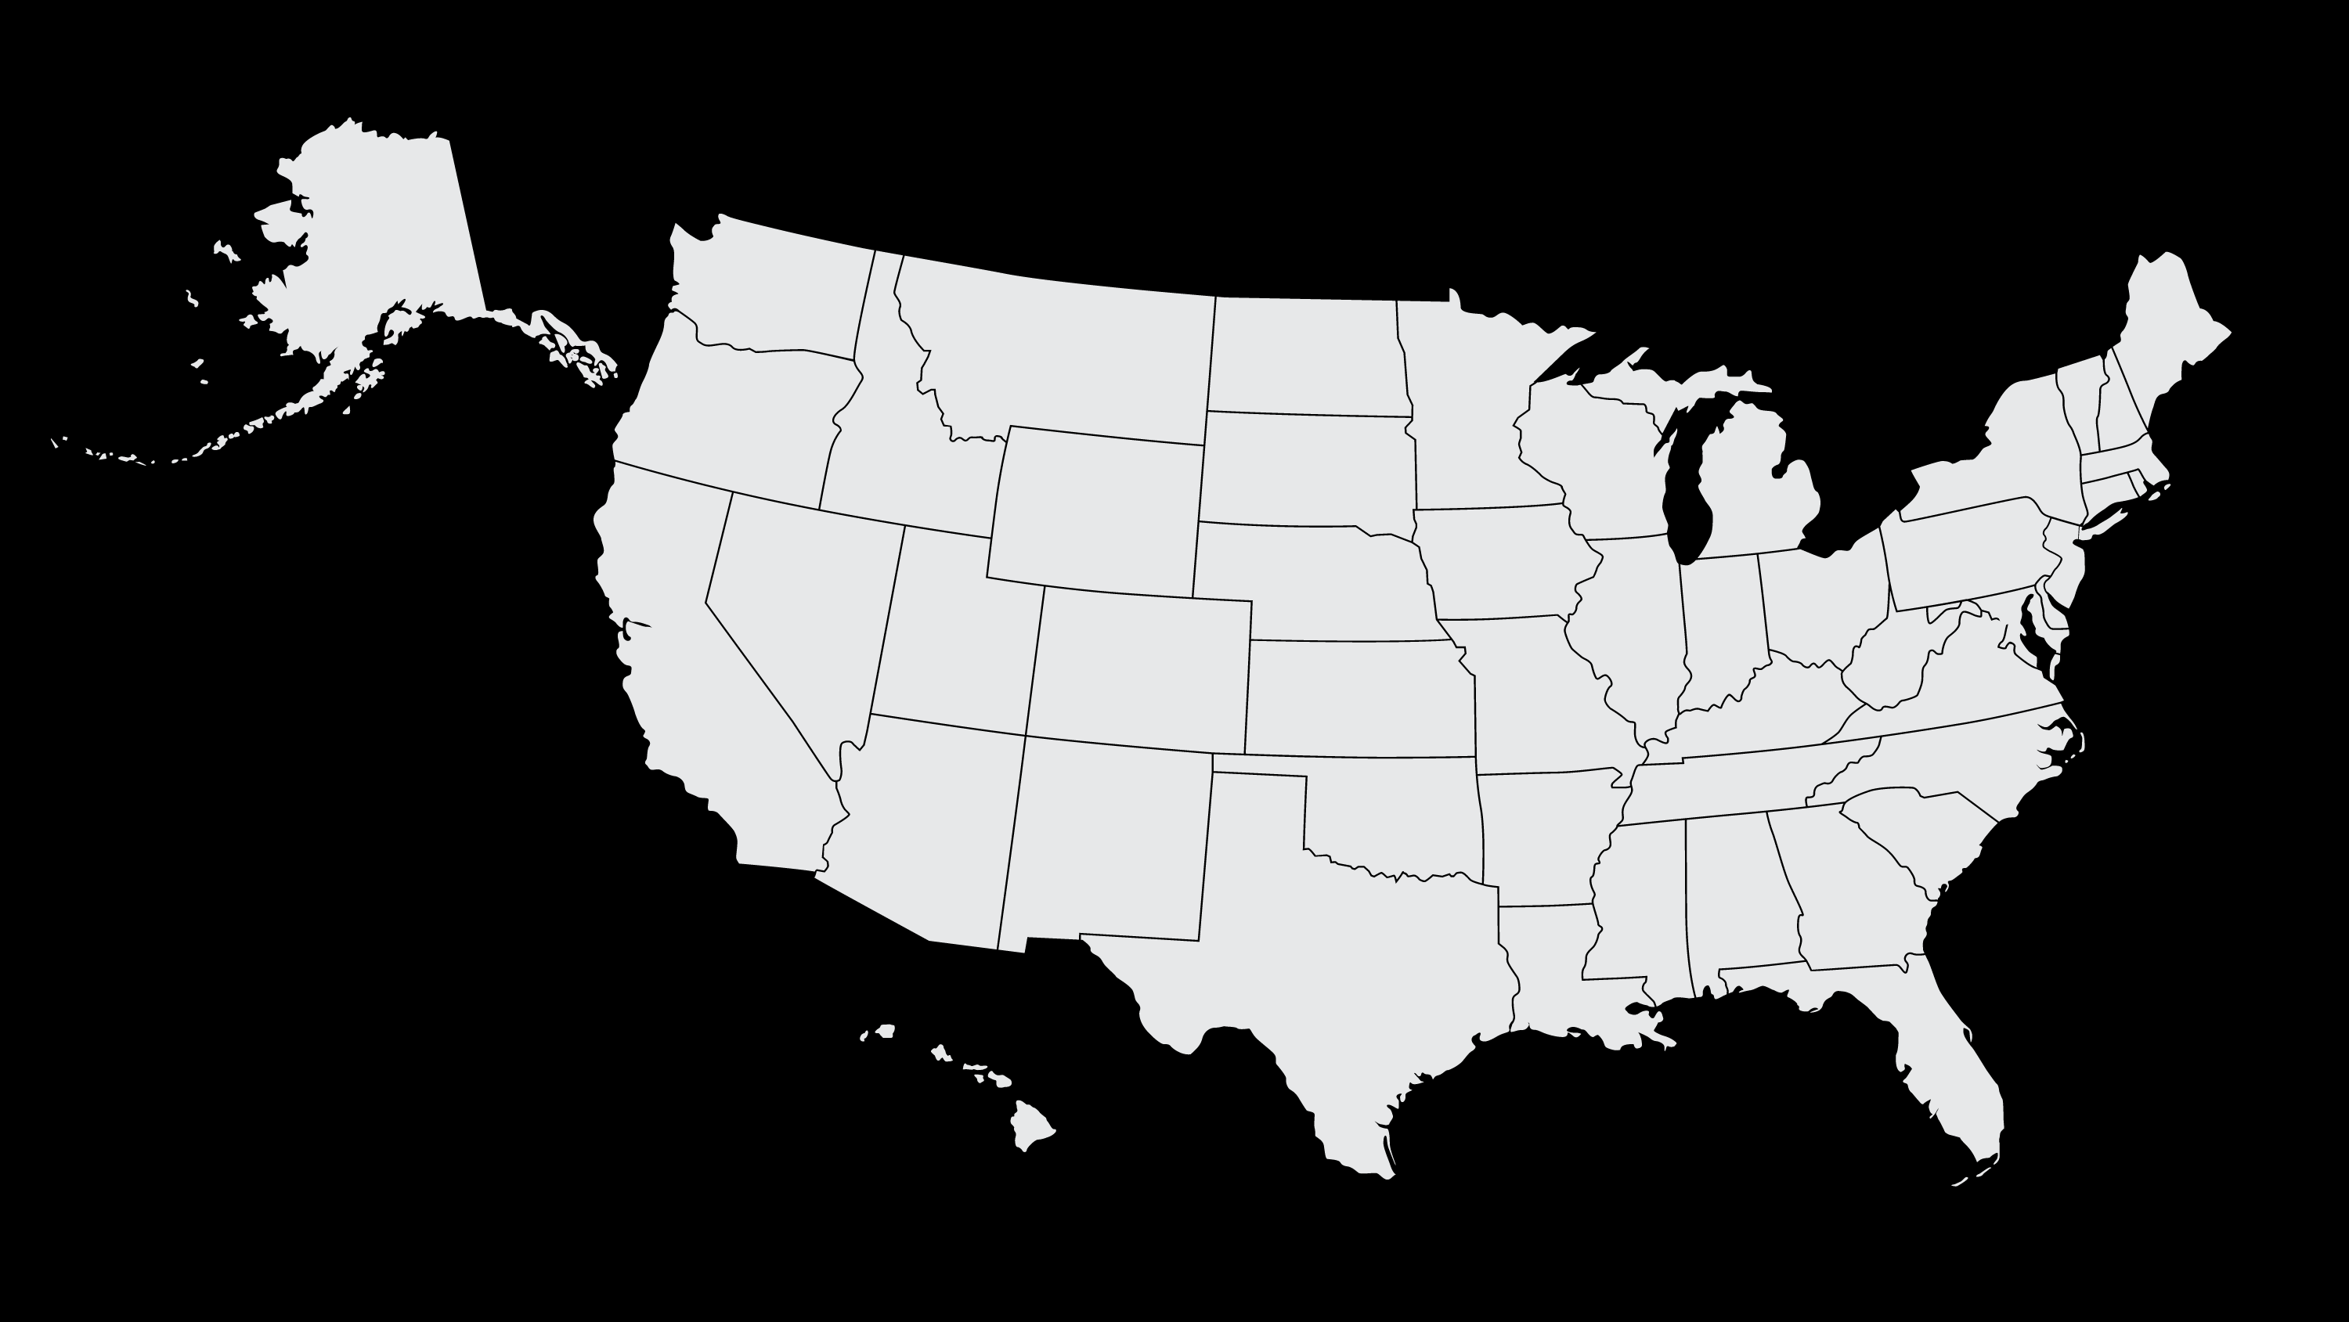
The Legal Basics: State Law
Data Breach - Generally Require:
Notification to affected individuals
Other “compensation”?
Notification of State AG?
Understand implications of “encryption”
Which party is responsible for data breaches
How is it determined?
What is the role of third parties?

Slide 16
State Omnibus Privacy Laws – Now Nine States
California:
  California Consumer Privacy Act (2018; effective Jan. 1, 2020)
  California Privacy Rights Act (2020; fully operative Jan. 1, 2023)
Colorado
  Colorado Privacy Act (2021; effective July 1, 2023)
Connecticut
  Connecticut Data Privacy Act (2022; effective July 1, 2023)
Indiana
  Indiana Consumer Data Protection Act (2023; effective Jan. 1, 2026)
Iowa
  Iowa Consumer Data Protection Act (2023; effective Jan. 1, 2025)
Montana
  Montana Consumer Data Privacy Act (2023, effective Oct. 1, 2024)
Tennessee
  Tennessee Information Protection Act (2023; effective July 1, 2024)
Utah
  Utah Consumer Privacy Act (2022; effective Dec. 31, 2023)
Virginia
  Virginia Consumer Data Protection Act (2021; effective Jan. 1, 2023)

Slide 17
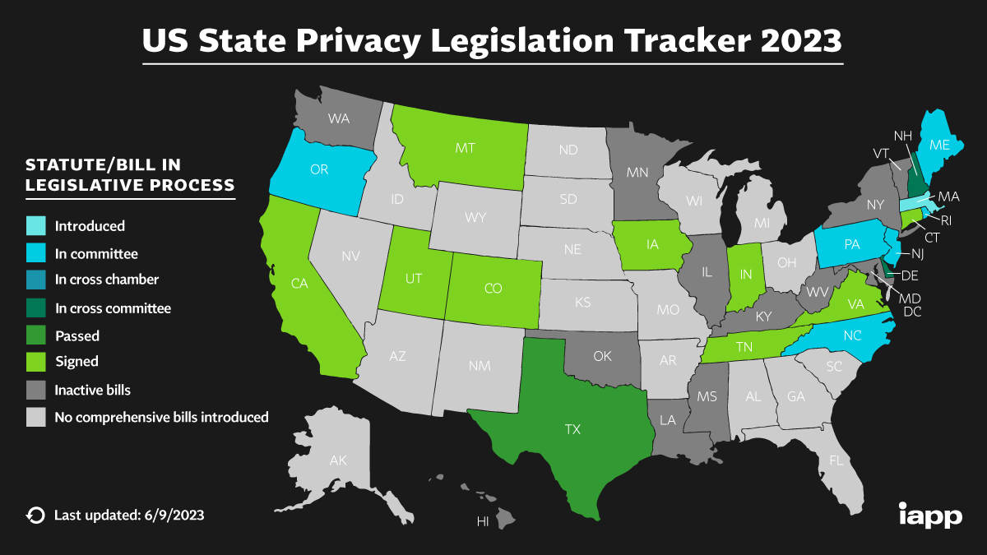

Slide 18
State Omnibus Privacy Laws
Open questions for Dealers/OEMs/Dealer Vendors:
GLB exemption (entity v. “data” level)
  Apply to Dealers?
How to comply?
How do vendors handle various requests? (website design, data deletion/control, etc.)
Private right of action
  CA only …. For now
Definition of sale/sharing
  For any consideration? For money only? Implications for OEM data sharing agreements?
OEMs and Large Dealer Groups - how to apply state specific laws across dealerships
  How to determine applicability?
  Multiple processes? Only to the “highest” bar?

