Slide 1
ADCO 2024 Data Privacy Update

Slide 2
Disclaimer
This presentation is provided for informational purposes only. The presentation is not intended to be an exhaustive review of all laws on any subject. We have made every effort to ensure that the information in this presentation is complete and accurate with respect to the topic(s) addressed. Hudson Cook, LLP and the individual presenter(s) are not responsible for any errors in or omissions from the information provided.
Nothing in this presentation should be construed as legal advice from Hudson Cook, LLP or the individual presenter, nor is the presentation a substitute for legal counsel on any matter. Legal advice must be tailored to specific facts and circumstances. No attendee of this presentation should act or refrain from acting solely on the basis of any information included in this presentation. Attendees should seek appropriate legal or other professional advice on legal matters specific to their business.
The views and opinions in this presentation are those of the presenter and do not necessarily represent official policy or position of Hudson Cook, LLP or of its clients.

Slide 3
State Privacy Update
What’s New?
Overview of Current State Privacy Laws:
Away from notice and choice to set limits
Trending to more consumer rights and less ability to use and share
Standard Provisions:
Consumer Rights
Access, Portability, and Correction
Consumer-requested limits: selling, sharing for online marketing, or doing much of anything with sensitive personal data
Transparency and Notices
Data Security Requirements
Approaches for Dealers:
Transparency and Communication
Data Rights Management
Data Security Measures
Training and Compliance
Uncommon Issues:
Biometric Data (IL)
Sensitive Data Categories (CO)
Automated Decision-Making (CA & VA)

Slide 4
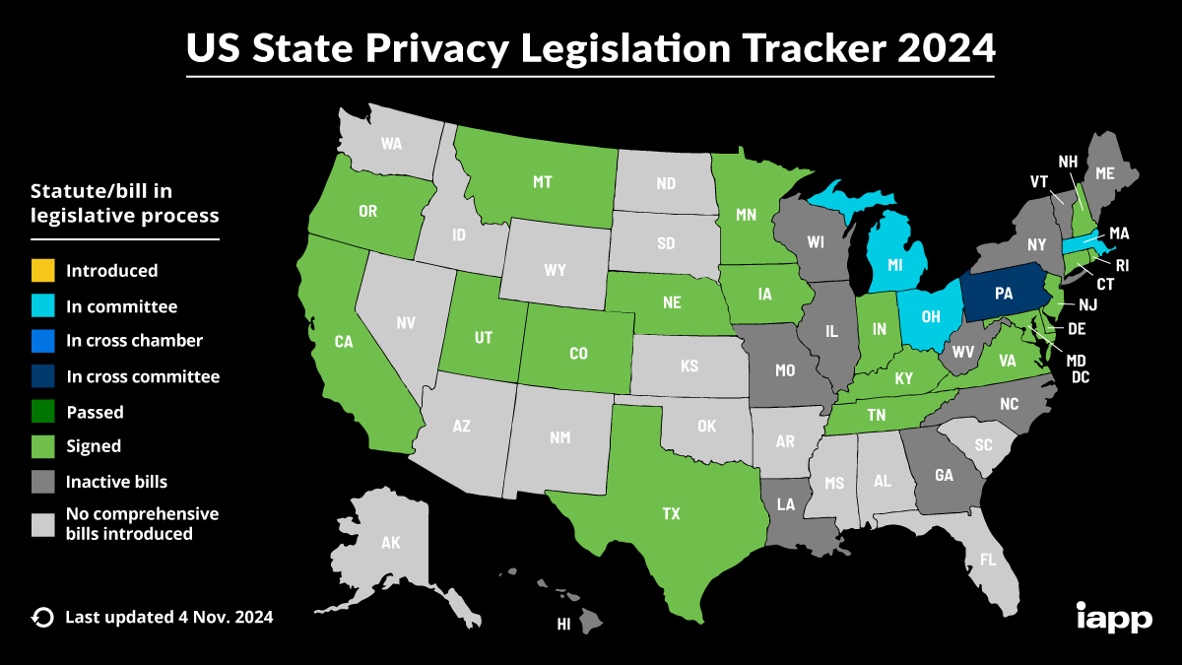
State Privacy Update

Slide 5
How this relates to dealer websites
Website Compliance with State Privacy Laws:
Dealers must include privacy policies that inform consumers of their data rights under each applicable state law.
Mechanisms for consumers to submit data subject requests (such as Do Not Sell links) are required on many websites.
Other Privacy Risks
Data Collection & Retention Practices:
Websites often use cookies and trackers that collect user data, which requires consumer consent and management.
Third-Party Sharing Risks:
Sharing data with third-party vendors may increase compliance risks under state laws if data protection standards aren’t met.

Slide 6
What to consider for vendors
Ensuring Vendor Compliance:
Vendors managing customer data must be contractually required to meet state privacy standards.
Use Data Processing Agreements (DPAs) to specify vendor obligations, including data security, breach notification, and rights to audit.
Data Sharing & Secure Transfer:
Establish secure protocols for transferring data between your dealership and vendors, ensuring encryption and other security controls are in place.
Conduct regular audits and assessments of vendor practices to ensure compliance.

Slide 7
Physical Notes, Data Hygiene, and 1033
Physical Notices:
For dealerships with in-person customer interactions, clear physical notices about privacy practices may be required, especially under Texas laws.
Data Hygiene
Data Accuracy: Regularly update and correct consumer data to meet regulatory standards.
Data Minimization: Collect only necessary data and ensure proper deletion after use.
Secure Data Disposal: Follow secure data disposal practices as outlined by FTC guidelines.
1033 Considerations
Under Section 1033 of the Dodd-Frank Act, consumer financial data must be portable, secure, and accessible, impacting data practices in dealerships.

Slide 8
Enforcement Risks
State-Level Enforcement Risks
Violations of state privacy laws can lead to fines, audits, and compliance orders by state attorneys general.
California’s CCPA/CPRA and Colorado’s CPA are known for their active enforcement.
Texas-Specific Risks
Texas Attorney General has taken actions under the Texas Deceptive Trade Practices Act (DTPA) and other consumer protection laws related to privacy.
Be cautious about marketing practices, as non-compliance can lead to significant penalties in Texas.
Mitigation Strategies
Implement thorough compliance checks, audit your data processing practices, and engage in staff training on privacy law.

Slide 9
How to confidently handle cybersecurity safeguards
Developing Strong Cybersecurity Safeguards
Conduct regular risk assessments, use multi-factor authentication, encrypt data, and implement access control to reduce risk.
Incident Response Plans:
Prepare a data breach response plan, including immediate notification to affected consumers and regulators as required by law.
Ongoing Audits and Training:
Conduct regular audits of your data systems and offer continuous training to employees to ensure they understand data protection responsibilities.

Slide 10
CONTACT
Webb McArthur
Hudson Cook LLP
(202) 715.2012
wmcarthur@hudco.com
Jennifer Sarvadi
Hudson Cook LLP
(202) 715.2012
jsarvardi@hudco.com

