Slide 1
“The Impact of COVID on Retention, Recruitment and Employment Practices in the Dealership”
September 23, 2021
Join the Roundtable Conversation!

Slide 2
DISCLAIMER
The information by the noted presenters is provided for general informational purposes only and may not reflect the current law in your jurisdiction. Nothing in their presentations should be construed as legal advice from the Association of Dealership Compliance Officers or the individual presenter, nor is it intended to be a substitute for legal counsel on any subject matter. The views and opinions in the presentations are those of the presenters and do not necessarily represent official policy or position of the Association of Dealership Compliance Officer or its members or advisors.
No attendee of this presentation should act or refrain from acting on the basis of any information included in this presentation without seeking the appropriate legal or other professional advice on the particular facts and circumstances at issue from a lawyer licensed in the attendee’s state, country or other appropriate licensing jurisdiction.
Copyright © 2018 – 2021 by Linda J. Robertson All rights reserved. No part of this publication may be reproduced, distributed, or transmitted in any form or by any means, including photocopying, recording, or other electronic or mechanical methods, without the prior written permission of the publisher, except in the case of brief quotations embodied in critical reviews and certain other noncommercial uses permitted by copyright law.
ASSOCIATION
OF DEALERSHIP
COMPLIANCE OFFICERS

Slide 3
AGENDA
Linda J. Robertson Welcome
Judy Vann Karstadt Introduction
Kelly S. Hughes, JD Presentation: To Mandate or Not to Mandate COVID-19 Vaccinations - What Employers Should Know
Debra Parent Employee Environment in Dealership
Sandy Zannino Recruitment & Turnover
Marica N Jackson, JD Tools to Protect the Dealership
ASSOCIATION
OF DEALERSHIP
COMPLIANCE OFFICERS

Slide 4
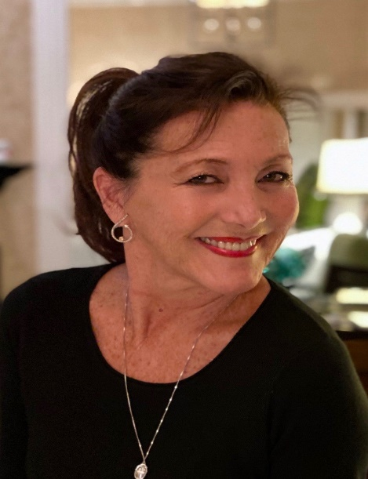
Moderator
Judy Vann Karstadt, MPFS, DCOP President, JV Solutions LLC Director of Training, NJCAR Academy
732-492-1818 Cell 732-332-0004 Office jvann592@gmail.com
ASSOCIATION
OF DEALERSHIP
COMPLIANCE OFFICERS

Slide 5
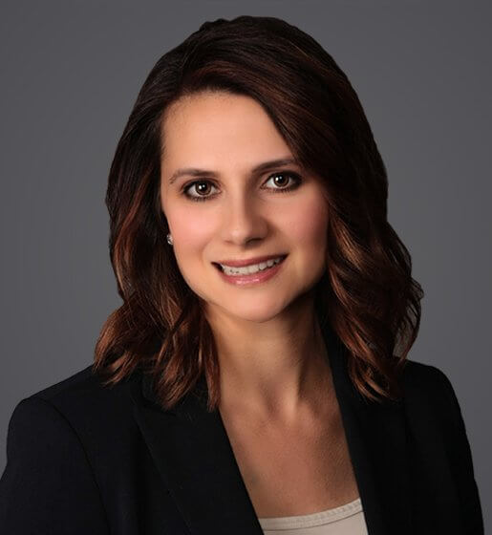
Presenter
Kelly is an employment lawyer who partners with employers and managers in three primary ways: litigation avoidance through proactive and compliant 50-state counseling and training; complex workplace investigations including at the C-Suite level; and litigating legally and factually challenging cases to defend employers’ actions. Kelly has successfully represented employers against allegations of discrimination, harassment, retaliation, and wrongful termination in state and federal court, as well as administrative forums. Kelly is a nationally-recognized authority on workplace flexibility and guides clients in creating and/or enhancing workplace flexibility tools (such as remote work, flexible scheduling, and the like), and she authored the legal chapters of the book Workflex: The Essential Guide to Effective and Flexible Workplaces as well as the Workflex and Employment Law Pocket Guide for SHRM’s When Work Works initiative. Kelly is an entertaining, sought-after speaker, traveling around the country delivering presentations on this and other cutting-edge topics, such as transgender rights in the workplace, to assist employers in creating an inclusive work environment for their employees. Kelly also authors articles and conducts presentations on mental health issues in the legal profession, particularly with respect to anxiety and OCD.
Within Ogletree, Kelly is the co-chair of the Retail Industry Group; a member of the EEOC Litigation, LOA/Reasonable Accommodation, Workplace Investigations, and Higher Education Practice Groups, and the co-chair of the Business Resource Group OD Family.
Kelly S. Hughes, JD
Shareholder
Ogletree Deakins
kelly.hughes@ogletree.com
704.405.3132
ASSOCIATION
OF DEALERSHIP
COMPLIANCE OFFICERS

Slide 6
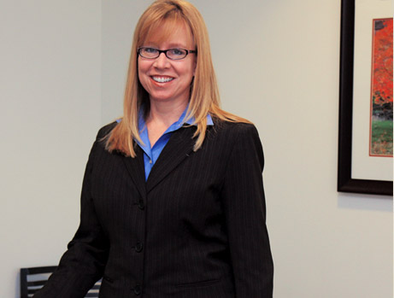
Panelist
Marcia Nelson Jackson is a partner in the Labor and Employment Group of Wick Phillips. Marcia’s practice includes all aspects of employment and labor law, strategic client counseling, preventative training, and internal investigations. In addition to representing employers in single and multi-plaintiff employment lawsuits, she regularly represents clients in wage and hour collective actions filed under the Fair Labor Standards Act, as well as disputes involving non-competition covenants and employee benefits litigation.
Marcia is a regular speaker on current issues to employers and serves on the Employment Law Editorial Advisory Board for Strafford Publications where she is a regular presenter on their nationwide teleconference Continuing Legal Education Programs.
She has previously been a presenter at the State Bar of Texas Advanced Employment Law Seminar, to the National Academy of Arbitrators and has been a contributing editor to the Texas Employment Law treatise.
Marcia Nelson Jackson
Partner
Wick Phillips
marcia.jackson@wickphillips.com
214.740.4024
ASSOCIATION
OF DEALERSHIP
COMPLIANCE OFFICERS

Slide 7
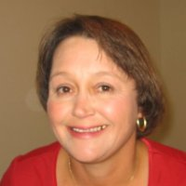
Panelist
Debra Parent, SHRM-SCP, SPHR, PHRca Director of Human Resources
McKenna Auto Group (562) 868-3233
dparent@mckennacars.com
ASSOCIATION
OF DEALERSHIP
COMPLIANCE OFFICERS

Slide 8
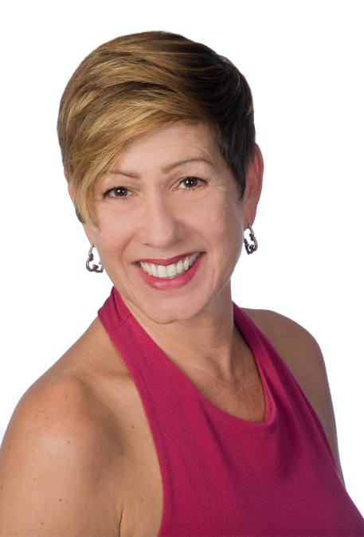
Panelist
Innovative Auto HR provides "Hassle Free HR Solutions" to Automotive Dealers.
The automotive industry presents unique risks and exposures regarding human resources. IAHR utilizes over 23 years of experience in the car business coupled with savvy and strategic human resources knowledge to offer solutions tailored to each client's needs.
Experienced and expert consulting, process driven solution creation in all areas of human resources: Compliant Onboarding/hiring process, Workers Compensation program aimed at lowering claims paid, Wage and Hour compliance, Obamacare compliance, Benefits Administration, Family Medical Leave compliance, On Demand HR consulting, OSHA reporting, I9 audits, Internal EEO Investigations and more. IAHR partners with dealerships to create best in class HR practices and processes without the overhead of an HR Department!
Sandy was HR Consultant of the Year Tampa / IICDP DEI Practitioner. She is passionate about creating positive change in retail automotive--one dealership at a time!
Sandy Zannino, SPHR, SHRM-SCP
Founder, President
Innovative Auto HR, LLC
941.306.8310
sandy@innovativeautohr.com
ASSOCIATION
OF DEALERSHIP
COMPLIANCE OFFICERS

Slide 9
To Mandate or Not to Mandate COVID-19 Vaccinations - What Employers Should Know
And Do You Still Have A Choice?
Presented by:
Kelly Hughes (Charlotte)

Slide 10
Biden Administration’s September 9 Announcement
OSHA is developing a rule that will require all employers with 100 or more employees:
ensure their workforce is fully vaccinated or
require any workers who remain unvaccinated to produce a negative test result on at least a weekly basis before coming to work
This will impact over 80 million private sector employees
We expect the ETS in the next few weeks

Slide 11
Open Questions on the General ETS
How quickly will employers have to comply?
How will the 100 employee threshold be calculated?
Who will have to pay for testing?
What are penalties for non-compliance?
Will there be challenges?

Slide 12
EEOC Position on Vaccination
Federal EEO laws do not prohibit policies requiring all employees who physically enter a workplace to receive a COVID-19 vaccination provided the policies comply with the reasonable accommodation provisions of the ADA and Title VII

Slide 13
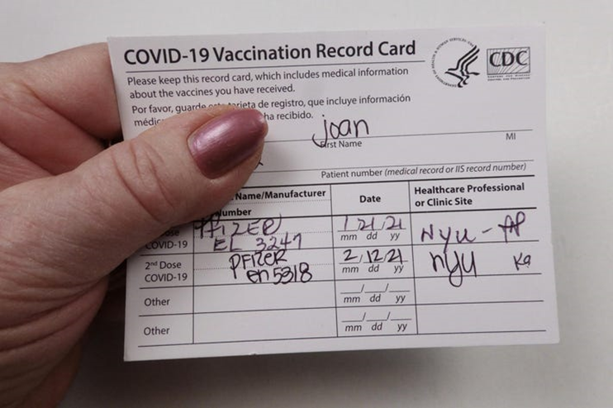
Proof of Vaccination? Federal Law Allows Employers to Ask About It
Honor system
Peek at card
Copy and save card
Attestation
“HIPAA” – does not apply
Confidentiality
Enforcement
Contact tracing

Slide 14
NLRA Considerations
Absent contract language, vaccination (or regular testing) would be mandatory subject of bargaining
Even with OSHA ETS, it gives options (vaccination and/or testing) so employers would have to bargain over how to implement

Slide 15
Incentivizing: Positive Reinforcement
Encouragement and incentives
One-time cash payment or gift cards
Paid time off for vaccination (or other extra PTO)
Rides to vaccination sites
Will incentives become moot for employers subject to the upcoming OSHA ETS or Federal Contractor rules?

Slide 16
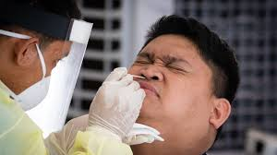
Negative Reinforcement
Penalties for remaining unvaccinated
Higher insurance premiums
Consult a benefits attorney
Regular testing
Unpaid sick days
Demotion, transfer, schedule change
Seclusion
Exclusion from large meetings and events
May be required under the new ETS

Slide 17
Legally-Required Accommodations:
Title VII requires covered employers to make reasonable accommodations for the sincerely held religious beliefs of employees or applicants if an accommodation will not impose more than a de minimis cost or burden on business operations
The ADA requires covered employers to make reasonable accommodations for the disabilities of employees

Slide 18
The Accommodation Requirement
If an employee’s accommodation request is denied, an employee can file an EEOC Charge of Discrimination and then a civil suit
If the employee establishes an entitlement to an accommodation that was denied, the employee can recover damages resulting from the failure to grant the accommodation, including back pay, front pay, emotional distress, and attorneys’ fees

Slide 19
The Steps to the Process – Religion
Does the belief conflict with a job requirement?
Does the person have a belief that is religious?
Is the belief sincerely held?
If the answer is “no” to any question →
no accommodation is legally required
Can a reasonable accommodation be made to how the job is done to enable the employee to perform an essential function of the job, without creating a direct threat or undue hardship?
If the answer is “yes” to all questions → an accommodation is required

Slide 20
Step 1: What Is Religion, Anyway?
EEOC Position
Employers should ordinarily assume that an employee’s request . . . is based on a sincerely held religious belief . . .”
However, if . . . an employer is aware of facts that provide an objective basis for questioning either the religious nature or the sincerity of a particular belief, practice, or observance, the employer would be justified in requesting additional supporting information

Slide 21
What Isn’t Religious?
Political beliefs**
Philosophical beliefs
Social beliefs
Medical beliefs
Concerns about FDA’s Emergency Use Authorization (EUA) status
Conspiracy theories
Limited and confined beliefs

Slide 22
Step 2: Is the Religious Belief Sincerely Held?
Whether someone “sincerely holds” the belief comes down to credibility
They say they hold the belief
Are they telling the truth about sincerely holding the belief, or is it a lie?

Slide 23
Step 3: Does the Belief Conflict With Vaccination?
If a belief is religious and sincerely held, does it conflict with the job requirement?
Example: if the employee professes an objection to wearing a face covering, but not to vaccination

Slide 24
Step 4: What Is an Undue Hardship?
Different standards under ADA and Title VII
An accommodation is an “undue hardship” if it would impose more than a de minimis cost to the employer based on both economic and non-economic costs.
What if the accommodation is merely to be unvaccinated?
Would an alternative accommodation (e.g., safety measures) eliminate undue hardship?

Slide 25
What Is an Undue Hardship Under Title VII?
EEOC Position
“Examples of burdens on business that are more than minimal (or an ‘undue hardship’) include: violating a seniority system; causing a lack of necessary staffing; jeopardizing security or health; or costing the employer more than a minimal amount.”
What You Should Know: Workplace Religious Accommodation
https://www.eeoc.gov/laws/guidance/what-you-should-know-workplace-religious-accommodation

Slide 26
Documentation
Forms memorializing the request for accommodation
Emails to/from employees about the request
Notes from interviews related to the request
Printouts of any webpages related to the religion
Printouts of any social media pages related to the employee’s statements about vaccines
Printouts of webpages that you relied on to research the employee’s statements (CDC, FDA, news articles, etc.) – these may be gone later on!
Documentation of conclusion

Slide 27
Overall Considerations – Religion
Should you make it a part of the process to provide counseling to employees from medical professionals about vaccination?
Do you want to scrutinize whether the belief is sincerely held and religious, and deny accommodations on that basis?
If an employee is entitled to an accommodation because the employee has a sincerely held religious belief, are you assessing undue hardship for that employee’s particular position on a case-by-case basis?
Are you assessing undue hardship such that you will be able to present specific facts in defense of the decision to deny an accommodation on that basis?

Slide 28
The Steps to the Process – Disabilities
Is the person disabled within the meaning of the ADA?
Does their disability conflict with receiving the vaccine?
If the answer is “no” to any question → no accommodation is legally required.
Can a reasonable accommodation be made to how the job is done to enable the employee to perform an essential function of the job, without creating a direct threat or undue hardship?
If the answer is “yes” to all questions → an accommodation is required

Slide 29
Undue Hardship/Direct Threat
Employers do not have to provide an accommodation if it would be an undue hardship
The definition of undue hardship is higher under the ADA than under Title VII
Accommodations are not required if the employee would pose a direct threat to health and safety of themselves or others

Slide 30
Final Considerations
If your organization requires employees to receive a COVID-19 vaccine, consider the degree to which your organization wants to take on the risk associated with denying accommodations
Do you want to review religiousness, sincerity, conflicts, or undue hardship?
Create non-privileged documentation of the decisional process
Assess and document undue hardship on a case-by-case basis

Slide 31
Takeaways
More and more employers are rolling out policies that require mandatory vaccination – and Biden’s announcement may further incentivize vaccination
It’s legal (subject to a couple of exceptions)
Should you implement?
Are you ready for the accommodation process?

Slide 32
Stay tuned . . .
OSHA ETS
Expected in a few weeks
Likely to be litigated
Federal Contractor Rule
To be published by September 24, then approved by OMB
Not all federal contractors covered

Slide 33
Thank you!
Kelly S. Hughes
Ogletree, Deakins, Nash, Smoak & Stewart, P.C.
201 S. College Street, Suite 2300
Charlotte, NC 28244
704.405.3132
Kelly.Hughes@Ogletree.com

Slide 34
DEBRA PARENT – Employee Environment In The Dealership
ASSOCIATION
OF DEALERSHIP
COMPLIANCE OFFICERS

Slide 35
ASSOCIATION
OF DEALERSHIP
COMPLIANCE OFFICERS

Slide 36
MARCIA JACKSON – Tools to Protect the Dealership
ASSOCIATION
OF DEALERSHIP
COMPLIANCE OFFICERS

Slide 37
The ADCO Team is ready to answer any questions about
membership or learning modules.
HOW TO REACH US
linda.robertson@adcocommunity.com
(682) 325-4381
www.adcocommunity.com

