Slide 1
Compliance Lessons Learned in 2024
& How to Apply in 2025
REDUCE RISK, BUILD TRUST, DELIVER VALUE
January 9th, 2025

Slide 2
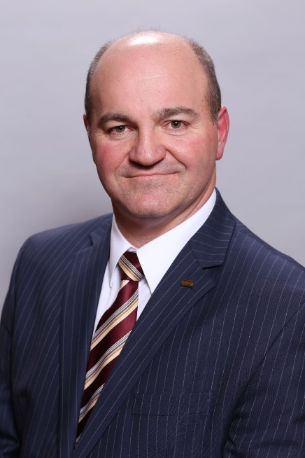
Shaun Petersen, JD
Shaun Petersen is the Executive Vice President and Chief Legal Officer for Buckeye Dealership Consulting, a leading provider of re-insurable products for automobile dealers. In this role, he is responsible for the company’s legal and compliance operations, partnerships, and other business strategies.
Prior to this appointment, Shaun served as the Senior Vice President of Legal & Government Affairs for the National Independent Automobile Dealers Association where he supervised all legislative and regulatory affairs for the association often appearing in front of the executive and legislative branches of both the federal and state governments. He was also responsible for the strategic engagement of NIADA’s political activities, including its political action committee. Shaun also served as General Counsel for the association.
Prior to his position with NIADA, Mr. Petersen was a founding partner in a boutique law firm in Columbus, Ohio representing businesses primarily in the automotive industry in matters related to state and federal consumer financial protection laws. He was a Senior Deputy Attorney General and Chief of the Consumer Protection Section in the Ohio Attorney General’s Office.
Shaun has appeared as a guest speaker at many conferences, provided numerous media interviews, and authored articles on legal, legislative, and regulatory topics impacting automobile dealers and the automotive industry.
Petersen attended Brigham Young University in Provo, Utah graduating with a B.A. in History. He received his J.D. from Capital University Law School in Columbus, Ohio.
Shaun Petersen
Executive Vice President & Chief Legal Officer
spetersen@buckeyereinsurance.com
330) 726-9030 Ext. 114
(614) 738-0960
REDUCE RISK, BUILD TRUST, DELIVER VALUE

Slide 3
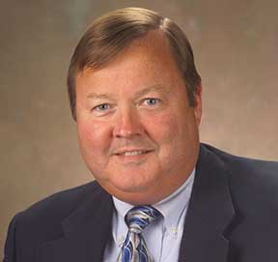
Terrence O’Loughlin, JD, MBA
Terrence J. O'Loughlin, J.D., M.B.A has nearly 30 years of legal and regulatory experience in motor vehicle-related fields.
From 1989 through 2006, O’Loughlin served with the Florida Office of the Attorney General, investigating and prosecuting automobile dealers, manufacturers, and financing and leasing companies. He led a task force that examined more than 100,000 motor vehicle files and settled with over 1600 vehicle dealers for more than $15,000,000.00.
O’Loughlin helped to draft and served as mediator of Florida’s Motor Vehicle Lease Disclosure Act.
He has served as a consultant to the Federal Reserve Board’s Leasing Education Committee and has routinely advised numerous states’ agencies on motor vehicle fraud.
Admitted to both the Pennsylvania and Florida Bars, O’Loughlin graduated from the University of Pittsburgh and received his graduate degrees from the University of Dayton.
Terry O’Loughlin, J.D., M.B.A.
Director of Compliance, Reynolds Document Solutions
Reynolds and Reynolds
7201 NW 80 Street | Tamarac, Florida 33321
office 954.718.9266 | mobile 954.616.7700 | fax 954.722.9772
terrence_oloughlin@reyrey.com
REDUCE RISK, BUILD TRUST, DELIVER VALUE

Slide 4
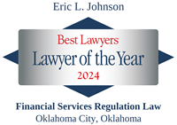
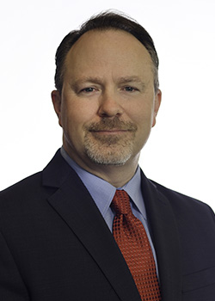
Eric Johnson, JD
Eric is a partner in the firm's Oklahoma City office and Editor in Chief of CounselorLibrary.com's Spot Delivery publication. He assists national and state banks, credit unions, licensed lenders, motor vehicles dealers and automotive finance companies in the development and maintenance of nationwide automobile finance programs; online motor vehicle sales programs; litigation funding programs; and electronic payment programs. Eric also assists DMS providers of documents and software with federal and state law compliance. He provides responses to regulator examinations; provides comments on proposed statutes and regulations to legislators and regulators; and assists financial services creditors with statutory and regulatory changes. Eric also assists financial services providers on e-commerce and information technology issues.
Eric serves as Chair of the Legal Committee for the National Automotive Finance Association and is a co-founder and co-instructor of their Consumer Credit Compliance Certification Program and Front-Line Compliance Certificates Program. Eric is a Fellow of the American College of Consumer Financial Services Lawyers and serves on its Nominating Committee. He also serves as Chair of the Governing Committee for The Conference on Consumer Finance Law and as Update Chair of the Financial Institutions and Commercial Law Section of the Oklahoma Bar Association.
Eric is listed in the 2025 edition of The Best Lawyers in America® in the practice areas of Banking and Finance Law, Commercial Litigation, Financial Services Regulation Law and Litigation-Banking & Finance.
Eric L. Johnson
Partner
Hudson Cook, LLP
405.602.3812 ejohnson@hudco.com
REDUCE RISK, BUILD TRUST, DELIVER VALUE

Slide 5
DISCLAIMER
The information by the noted presenters is provided for general informational purposes only and may not reflect the current law in your state or jurisdiction. Nothing in this presentation should be construed as legal advice from the Association of Dealership Compliance Officers or the individual presenter, nor is it intended to be a substitute for legal counsel on any subject matter. The views and opinions in this presentation are those of the presenters and do not necessarily represent the official policy or position of the Association of Dealership Compliance Officers or its members or advisors.
No attendee of this presentation should act nor refrain from acting on the basis of any information included in this presentation without seeking the appropriate legal or other professional advice on the particular facts and circumstances at issue from a lawyer licensed in the attendee’s state, country, or other appropriate licensing jurisdiction.
Copyright © 2025 by Linda J. Robertson All rights reserved. No part of this publication may be reproduced, distributed, or transmitted in any form or by any means, including photocopying, recording, or other electronic or mechanical methods, without the prior written permission of the publisher, except in the case of brief quotations embodied in critical reviews and certain other noncommercial uses permitted by copyright law.
Dealership Compliance Officer Professional Certification Seminar

Slide 6
The Politics of 2025 – Expectations with a Trump Administration
Shaun K. Petersen – Executive Vice President and Chief Legal Officer, Buckeye Dealership Consulting
REDUCE RISK, BUILD TRUST, DELIVER VALUE
January 9, 2025

Slide 7
The Trump Philosophy and Outcome
First Term
For every new regulation, 2 come off the books
Less regulations – FY2017 – FY2019 eight cut for every significant one added
End of regulation by enforcement
Less enforcement cases, targeted enforcement
Increased state activity – mini-CFPB’s, active AG enforcement
Tax Cuts and Jobs Act
REDUCE RISK, BUILD TRUST, DELIVER VALUE

Slide 8
The Trump Philosophy and Outcome
Second Term
10 to 1 ratio on regulations
Future of EVs
Rolling back regulations hindering oil and gas drilling and coal mining
Rescind all unspent funds under the Inflation Reduction Act – EV subsidies
Reverse light duty vehicle emission standards (i.e. EV mandate)
Protectionist trade environment – tariffs?
Tax policy
Extend Tax Cuts and Jobs Act
Lower corporate rate from 32% to 15% for domestic production
No tax on tips, SSI, or overtime pay
REDUCE RISK, BUILD TRUST, DELIVER VALUE

Slide 9
The Trump Philosophy and Outcome
Second Term
Congressional Review Act
New Agency appointees
DOGE impact
Consumer Rights Activity
“[Democratic] AGs have also become the muscle of the resistance.”
“In this second term, we will redouble our efforts to partner with civil rights and grassroots organizations to defend consumer rights.” – NCLC
Democratic State AG’s, state banking/financial agencies, pro-consumer bar, consumer rights groups will get active
(Trump 1 was sued 155 times by Democrat AGs)
REDUCE RISK, BUILD TRUST, DELIVER VALUE

Slide 10
Trump 2 and the FTC
New Leadership
New Chairman - Andrew Ferguson
Does NOT need Senate confirmation
Former Virginia Solicitor General from 2022 to 2024
Former Chief Counsel for Senate Minority Leader Mitch McConnell
New Commissioner – Mark Meador
Former Deputy Chief Counsel to Sen. Mike Lee
Will need Senate confirmation
Recess appointment?
New Bureau heads likely
REDUCE RISK, BUILD TRUST, DELIVER VALUE

Slide 11
Trump 2 and the FTC
Strategy
More constrained
Less rulemaking
Less enforcement focus
Congressional deference
Narrow interpretations/prosecutorial discretion
Pending Rules in litigation
CARS Rule
Non-compete Rule
REDUCE RISK, BUILD TRUST, DELIVER VALUE

Slide 12
Trump 2 and the CFPB
Strategy
More constrained
Less rulemaking
Less enforcement focus
Congressional deference
Narrow interpretations/prosecutorial discretion
The DOGE effect
Going away?
Congressional involvement
Funding
New Leadership - TBD?
REDUCE RISK, BUILD TRUST, DELIVER VALUE

Slide 13
Executive Vice President and Chief Legal Officer, Buckeye Dealership Consulting
Shaun Petersen
Executive Vice President & Chief Legal Officer
spetersen@buckeyereinsurance.com
330) 726-9030 Ext. 114
(614) 738-0960
linkedin.com/in/shaunkpetersen
REDUCE RISK, BUILD TRUST, DELIVER VALUE

Slide 14
CARS Rule (Combating Auto Retail Scams Rule)
vs. Vehicle Shopping Rule (VSR)
Terry O’Loughlin, Director of Compliance at Reynolds & Reynolds
REDUCE RISK, BUILD TRUST, DELIVER VALUE
January 9th, 2025

Slide 15
AGENDA
History and Current Status
Perspectives
The Rule
Key Provisions
Chief Concerns for the Underwriting Community
Some Solutions and Recommendations
Predictions
REDUCE RISK, BUILD TRUST, DELIVER VALUE

Slide 16
History and Current Status
1-4-24: The CARS (Vehicle Shopping) Rule was published in the Federal Register at 89 FR 590-01; effective date July 30, 2024.
1-4-24: NADA and TADA filed suit against the FTC challenging the Vehicle Shopping Rule.
1-10-24: NADA and TADA filed a Motion to Stay the FTC’s Final Vehicle Shopping Rule in the U.S. Court of Appeals for the 5th Circuit.
1-18-24: The 5th Cir issued a stay on the on rule on January 18, 2024 (postponing the effective date to allow for judicial review).
2-22-24: The stay was reported in the Federal Register on February 22, 2024, and notes that the effective date of the final rule is delayed indefinitely. The FTC will publish a subsequent notification in the Federal Register announcing the effective date.
5-14-24: The FTC filed its Appellee/Respondent Brief.
7/24: The U.S. Court of Appeals Fifth Circuit set a tentative date for the oral arguments in the lawsuit filed by the NADA and Texas ADA against the Federal Trade Commission on the Combatting Auto Retail Scams rule for Oct. 7, 2024.
10/9/24: The U.S. Court of Appeals for Fifth Circuit held oral arguments.
REDUCE RISK, BUILD TRUST, DELIVER VALUE

Slide 17
Potential Timeline and Results
Decision could be imminent or as long as a year.
NADA/TADA requested court vacate rule, or in the alternative, to remand to FTC to cure procedural errors.
Not taking bets on who wins here.
REDUCE RISK, BUILD TRUST, DELIVER VALUE

Slide 18
Why Who Wins Only Matters a Little
FTC Vehicle Shopping Rule gives roadmap of UDAPS and potential UDAPs going forward that should not surprise industry.
Rule does require cleaner deals.
Rule requires additional disclosures and documentation.
Rule does impose additional record keeping requirement.
Otherwise, UDAPs existed before the rule will continue to be UDAPS.
REDUCE RISK, BUILD TRUST, DELIVER VALUE

Slide 19
Perspectives
There are over 153 ways to defraud consumers in a vehicle purchase or lease transaction.
Consumer complaints regarding vehicle issues have been the top complaint for attorneys general for the past forty years.
FTC - “When Americans set out to buy a car, they’re routinely hit with unexpected and unnecessary fees that dealers extract just because they can,” said FTC Chair Lina M. Khan. “The CARS Rule will prohibit exploitative junk fees in the car-buying process, saving people time and money and protecting honest dealers.”
NADA - “This regulation is heavy-handed bureaucratic overreach and redundancy at its worst, that will needlessly lengthen the car sales process by forcing new layers of disclosures and complexity into the transaction. The FTC made up data to support its claims, then rejected calls to slow down the process and test the effectiveness of its proposal with real consumers. We are exploring all options on how to keep this ill-conceived rule from taking effect.”
The Commission estimates that the rule will save car-buying consumers an estimated $3.4 billion dollars and 72 million hours each year.
A study by the Center for Automotive Research (CAR) found that this rule will increase costs on consumers and small business dealers by $24.1 billion over 10 years and affect over 40 million consumer vehicle transactions and hundreds of millions of vehicle shopping inquiries each year.
REDUCE RISK, BUILD TRUST, DELIVER VALUE

Slide 20
The CARS Rule
PART 463—COMBATING AUTO RETAIL SCAMS TRADE REGULATION RULE
Authority: 15 U.S.C. 41 et seq.; 12 U.S.C. 5519.
463.1 Authority.
463.2 Definitions.
463.3 Prohibited misrepresentations.
463.4 Disclosure requirements.
463.5 Dealer charges for Add-ons and other items.
463.6 Recordkeeping.
463.7 Waiver not permitted.
463.8 Severability.
463.9 Relation to State laws.
REDUCE RISK, BUILD TRUST, DELIVER VALUE

Slide 21
Key Provisions
REDUCE RISK, BUILD TRUST, DELIVER VALUE

Slide 22
§ 463.2 Definitions
“Add-on” or “Add-on Product(s) or Service(s).”
“Clear(ly) and Conspicuous(ly).”
“Covered Motor Vehicle.”
“Covered Motor Vehicle Dealer.”
“Express, Informed Consent.”
“GAP Agreement.”
“Government Charges.”
“Material” or “Materially.”
“Offering Price.”
REDUCE RISK, BUILD TRUST, DELIVER VALUE

Slide 23
§ 463.3 Prohibited Misrepresentations
16 Prohibitions.
Old wine in new bottles.
REDUCE RISK, BUILD TRUST, DELIVER VALUE

Slide 24
Misrepresentations Regarding:
Financing, or leasing a vehicle.
Add-on Product or Service.
Is it a sale or a lease?
Rebates or discounts.
Availability of vehicles at advertised price.
Financing preapprovals.
Credit Application.
Spot Deliveries.
Trade-in Pay Off.
Dealer reviews.
Government affiliation.
Prizes or sweepstakes.
Where a vehicle can be moved.
Repossession.
Catchall- “Any of the required disclosures identified in this part.”
REDUCE RISK, BUILD TRUST, DELIVER VALUE

Slide 25
§ 463.4 Disclosure Requirements
Offering Price.
Add-ons not required.
Total of payments and consideration for a financed or lease transaction.
Monthly payments comparison.
REDUCE RISK, BUILD TRUST, DELIVER VALUE

Slide 26
463.5 Dealer Charges for Add-ons and Other Items
Add-ons that provide no benefit.
Any item without Express, Informed Consent.
REDUCE RISK, BUILD TRUST, DELIVER VALUE

Slide 27
463.6 Recordkeeping
Must be kept for twenty-four months.
Copies of all Materially different advertisements, sales scripts, training materials, and marketing materials.
Copies of all documents and written communications whether or not final approval is received.
Records demonstrating that Add-ons in consumers’ contracts meet the requirements of§463.5.
Copies of all written consumer complaints, as well as verbal inquiries and responses.
REDUCE RISK, BUILD TRUST, DELIVER VALUE

Slide 28
Chief Concerns for the Underwriting Community
Holder Rule
The Trade Regulation Rule Concerning Preservation of Consumers’ Claims and Defenses (aka the Holder Rule) began in 1975. The VSR may give it new vitality.
The Rule does not exempt transactions from the application of the Holder Rule.
Potential new daunting legal perils may apply to the underwriting community.
Should financing sources seek additional representations and warranties in their dealer agreements such as audits, new compliance obligations, indemnification, training requirements, and advertising collaboration? Would this new requisite duties further integrate OEMs with dealers for further liability?
REDUCE RISK, BUILD TRUST, DELIVER VALUE

Slide 29
Some Solutions and Recommendations
Review dealer agreements.
AFSA and other trade organizations become all the more important.
The Rule has the potential for legal mischief.
Education.
Review consumer facing documents.
And create some new ones.
REDUCE RISK, BUILD TRUST, DELIVER VALUE

Slide 30
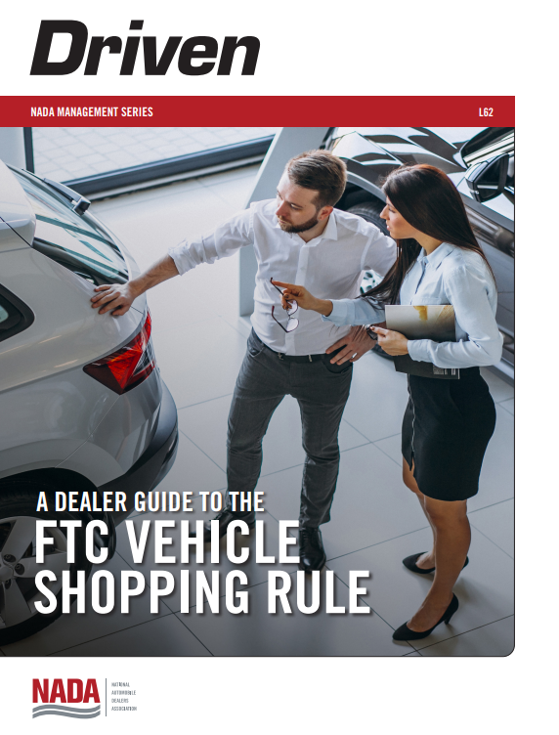
REDUCE RISK, BUILD TRUST, DELIVER VALUE

Slide 31
Predictions and Sundry Considerations
5th Circuit.
REDO Act.
New Republican Administration.
Replacement of Lina Khan and Republican Control of FTC.
Junk Fee Rule.
It will survive regardless of outcome, but the form may be different.
REDUCE RISK, BUILD TRUST, DELIVER VALUE

Slide 32
Questions?
Contact Me
Scan Here
Terry O’Loughlin
(954) 718-9266
terrence_oloughlin@reyrey.com
LAW553.com
For a free F&I
Document Review
Terrence O’Loughlin, Director of Compliance, Reynolds Document Solutions
REDUCE RISK, BUILD TRUST, DELIVER VALUE

Slide 33
CTA and FTC Junk Fees Rule
Eric Johnson, Partner, Hudson Cook, LLP
REDUCE RISK, BUILD TRUST, DELIVER VALUE
January 9, 2025

Slide 34
Corporate Transparency Act
Background on CTA:
Corporate Transparency Act (“CTA”) requires many companies formed or operating in the United States to report information about their beneficial owners to the US Treasury’s Financial Crimes Enforcement Network (“FinCEN”).
In September 2022, FinCEN issued the final beneficial ownership information (“BOI”) reporting rule, describes who must file, what info. must be reported and when report is due.
Effective January 1, 2024, the rule requires certain domestic and foreign companies doing business in the United States to report their BOI to FinCEN.
There are 23 exemptions from the definition of “reporting company” for various entities, including a “large operating company” exemption. To fall within this exemption, entity must satisfy all of the these criteria:
The entity employs more than 20 full time employees in the “United States.”
The entity has an operating presence at a physical office within the United States.
The entity filed a federal income tax or information return in the United States for the previous year reporting more than $5,000,000 in gross receipts or sales (net of returns and allowances) on the entity’s IRS Form 1120, consolidated IRS Form 1120, IRS Form 1120-S, IRS Form 1065, or other applicable IRS form, excluding gross receipts or sales from sources outside the United States.
REDUCE RISK, BUILD TRUST, DELIVER VALUE

Slide 35
Corporate Transparency Act
Filing Deadlines:
The deadline for filing an initial BOI report depends on when the reporting company is created:
A reporting company that has been formed or registered before January 1, 2024, must file its initial BOI report by January 1, 2025. FinCEN extended this deadline until January 13, 2025, as a result of recent litigation, but FinCEN is currently enjoined from enforcing the CTA’s filing requirements.
Reporting companies created or registered on or after January 1, 2024, and before January 1, 2025, must file their initial BOI report within 90 calendar days after the time the company receives actual notice that its creation or registration is effective, or after a secretary of state or similar office first provides public notice of its creation or registration, whichever is earlier. Deadline extended to January 13, 2025, but FinCEN is currently enjoined from enforcing the CTA’s filing requirements.
Reporting companies created or registered on or after January 1, 2025, will have 30 calendar days from actual or public notice that the company’s creation or registration is effective to file their initial BOI reports with FinCEN.
REDUCE RISK, BUILD TRUST, DELIVER VALUE

Slide 36
Corporate Transparency Act
Penalties for Not Filing BOI or Filing False Info.:
The penalties under the CTA for filing false beneficial ownership information or for failure to report or update beneficial ownership information are:
Civil penalties of $500 for each day that the violation continues or has not been remedied; and
Criminal fine of up to $10,000, imprisonment for up to two years, or both.
REDUCE RISK, BUILD TRUST, DELIVER VALUE

Slide 37
Corporate Transparency Act
Litigation Developments:
National Small Business United v. Yellen: In March 2024, a federal district court in Alabama held the CTA to be unconstitutional “[b]ecause the CTA exceeds the Constitution’s limits on the legislative branch and lacks a sufficient nexus to any enumerated power to be a necessary or proper means of achieving Congress’ policy goals . . .” and granted an injunction against enforcement of the CTA to the plaintiffs. In response to the decision, FinCEN posted a notice to its website which noted that the Department of Justice has filed a Notice of Appeal on March 11, 2024.
Texas Top Cop Shop v. Garland: On December 3, 2024, the United States District Court in the Eastern District of Texas, Sherman Division, declared the CTA to be “likely unconstitutional” and issued a preliminary injunction against enforcement of the CTA. The Texas preliminary injunction applied to all reporting companies nationwide and stayed all deadlines to comply with BOI reporting requirements.
December 5, 2024 - Department of Justice filed a Notice of Appeal on behalf of the Department of Treasury, appealing the decision to the Fifth Circuit as well as an emergency motion for a stay of the injunction pending appeal.
REDUCE RISK, BUILD TRUST, DELIVER VALUE

Slide 38
Corporate Transparency Act
Litigation Developments:
December 23, 2024 - motions panel of the Fifth Circuit Court of Appeals granted FinCEN’s emergency motion for a stay pending appeal, ruling that the stay is in the "public's urgent interest in combating financial crime and protecting our country's national security." The order also expedited the appeal to the next available oral argument panel. = Companies required to file BOI and FinCEN extended deadlines to file (Jan. 13, 2025).
December 26, 2024 - merits panel for the Fifth Circuit vacated the prior order of the motions panel, thereby reinstating the preliminary injunction against enforcement of the CTA and FinCEN’s BOI reporting rule. = Companies not required to file BOI.
The schedule for briefing and oral arguments on the merits is as follows:
February 7, 2025 – appellant's (government) brief due
February 21, 2025 – appellee's (plaintiffs) brief due
February 28, 2025 – government's reply brief
March 25, 2025 – oral argument
REDUCE RISK, BUILD TRUST, DELIVER VALUE

Slide 39
Corporate Transparency Act
Litigation Developments:
December 31, 2024 - Justice Department filed an emergency application to the U.S. Supreme Court, asking the justices to overturn the Fifth Circuit decision on the preliminary injunction and to reinstate the CTA while the Fifth Circuit hears arguments and makes its decision on the merits.
Application argues that district court overreached by issuing a nationwide injunction, rather than limiting the injunction to just the parties who sued over the law.
If justices are willing to take up the application, it is possible that FinCEN will be enforcing the CTA and collecting BOI information pending resolution of the appeal proceedings.
REDUCE RISK, BUILD TRUST, DELIVER VALUE

Slide 40
FTC’s Junk Fee Rule - Update
December 17, 2024 - The FTC significantly limited the scope of its Final Junk Fees Rule. The Final Rule targets specific and widespread unfair and deceptive pricing practices in the sale of “live-event tickets and short-term lodging.”
The prohibitions on hidden fees (§ 464.2) and misleading fees (§ 464.3) are limited to a “Covered Good or Service.” Under the rule a “Covered Good or Service” means: (1) Live-event tickets; or (2) Short-term lodging, including temporary sleeping accommodations at a hotel, motel, inn, short-term rental, vacation rental, or other place of lodging.
As to businesses that aren’t specifically covered by the Final Rule (e.g., motor vehicle dealers), FTC’s press release stated that:
“Industries beyond live-event ticketing and short-term lodging are prohibited from deceiving consumers about fees and pricing per longstanding law. The FTC will use its law enforcement authority to continue to rigorously pursue bait-and-switch pricing tactics, such as drip pricing and misleading fees, in other industries through case-by-case enforcement.”
REDUCE RISK, BUILD TRUST, DELIVER VALUE

Slide 41
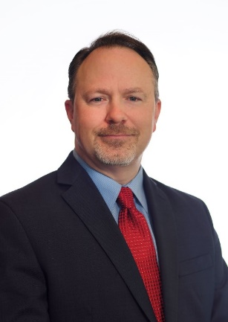
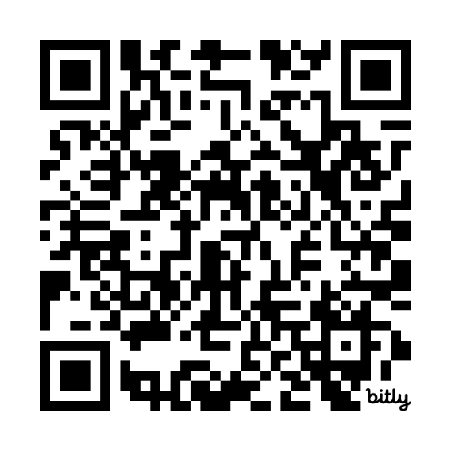
Eric Johnson, Partner, Hudson Cook, LLP
Contact me:
Hudson Cook, LLP
918 S.W. 107th St.
Suite 200
Oklahoma City, OK 73170
405.602.3812
405.590.9920
 ejohnson@hudco.com
linkedin.com/in/eric-johnson-attorney
REDUCE RISK, BUILD TRUST, DELIVER VALUE

Slide 42
The mission of the Association of Dealership Compliance Officers is to reduce business risk for dealers, protect their bottom lines, and enhance their reputation within the community. This is completed by training dealership compliance professionals and providing additional educational opportunities and resources to build and maintain an effective dealership compliance management and ethics program.
What I Learned at NADA and Need to Know for 2025
Feb. 11, 14, & 17, 2025 | 1-1:30 pm CST (ADCO Members)
Join this exclusive 3-Day Webinar series as we share key insights and game-changing takeaways from NADA.
REDUCE RISK, BUILD TRUST, DELIVER VALUE

Slide 43
February DCOP Essentials Seminar & Certification
February 19-21, 2025 | 10-4 pm CST
The Dealership Compliance Officer Seminar and Training with optional DCOP certification.
March Compliance Risk and Personal Liability
March 7, 2025 | 2 pm CST
Person Liability and Compliance for the Compliance Professional, Insurance – E&O.
March DCOP Essentials Seminar & Certification
March 10-12, 2025 | 10-4 pm CST
April Dealership Human Resources Webinar
April 17, 2025 | 11 am CST
Industry Human Resource attorney will provide Regulatory and Legal updates for 2025.
The Dealership Compliance Officer Seminar and Training with
optional DCOP certification.
REDUCE RISK, BUILD TRUST, DELIVER VALUE

Slide 44
April Front-Line Manager Compliance Training and Certification
April 22, 23, 2025 | 10-4 pm CST
A front-line manager plays a critical role in maintaining compliance by directly overseeing day-to-day operations, ensuring employees understand and follow company policies and procedures, identifying potential compliance risks within their teams, and taking immediate action to address any issues. They essentially act as the "first line of defense" in upholding regulatory and ethical standards within a dealership.
REDUCE RISK, BUILD TRUST, DELIVER VALUE

Slide 45
The ADCO Compliance Solution
https://www.adcocommunity.com/
Membership
Resources & Tools
FRAT - Federal Regulatory Annual Training
Compliance Professional Training and Certification
Compliance Programs
REDUCE RISK, BUILD TRUST, DELIVER VALUE

Slide 46
Join the Conversation!
https://www.adcocommunity.com/membership
REDUCE RISK, BUILD TRUST, DELIVER VALUE

Slide 47
Theme copy | Theme Copy | Theme Copy
Thank You!
REDUCE RISK, BUILD TRUST, DELIVER VALUE

