Slide 1
Quo Vadis CFPB? – Can Unfairness be the Basis for a Charge of Discrimination?
Prepared by:
Terrence J. O’Loughlin, J.D., M.B.A.
Director of Compliance
The Reynolds and Reynolds Company

Slide 2
Reynolds and Reynolds
The views, information, or opinions expressed during this content are solely those of the individuals involved and do not necessarily represent those of Bobit Business Media, its brands and its employees.

Slide 3
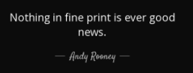
Fine Print and Legal Disclaimer
This presentation is not meant to provide you with legal advice. Please consult your attorney for legal advice.

Slide 4
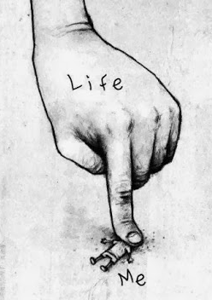
Woe is ME!
CFPB, FTC,
STATE AGO’S

Slide 5
AGENDA
The Constitution and Politics
CFPB Targets Discrimination Using UDAAP – Unfairness – March 2022
Legal Challenges – Past is Prologue
Fair Lending Defined
Overt Discrimination
Disparate Treatment
Disparate Impact
UDAAP
A Related Banker’s View
Recommendations and Comments

Slide 6
The Constitution

Slide 7
U.S. Constitution – 14th Amendment
SECTION 1.
All persons born or naturalized in the United States and
subject to the jurisdiction thereof, are citizens of the United
States and of the State wherein they reside. No State shall
make or enforce any law which shall abridge the privileges
or immunities of citizens of the United States; nor shall
any State deprive any person of life, liberty, or property,
without due process of law; nor deny to any person within
its jurisdiction the equal protection of the laws.

Slide 8
Equal Protection
The Equal Protection clause of the Fourteenth Amendment is one of the most litigated sections of the Constitution. As a brief overview, the clause refers to the fact that all citizens of the United States are guaranteed equal protection under the laws of the United States.
When a statute or ordinance discriminates against an individual or a class of individuals, and those individuals sue, the court will apply one of three levels of scrutiny to the law in question: Rational Basis, Intermediate Basis, or Strict Scrutiny.

Slide 9
DEI
Discrimination
Equity
Inclusion

Slide 10
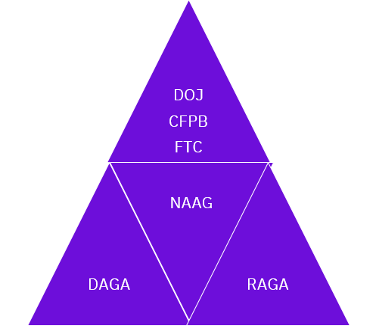
Federal and State Agencies Work Together – Jurisdiction is Rarely a Problem
DOJ – Department of Justice
CFPB – Consumer Financial Protection Bureau
FTC – Federal Trade Commission
NAAG – National Association of Attorneys General
DAGA – Democratic Attorney General Association
RAGA – Republican Attorney General Association

Slide 11
Politics

Slide 12
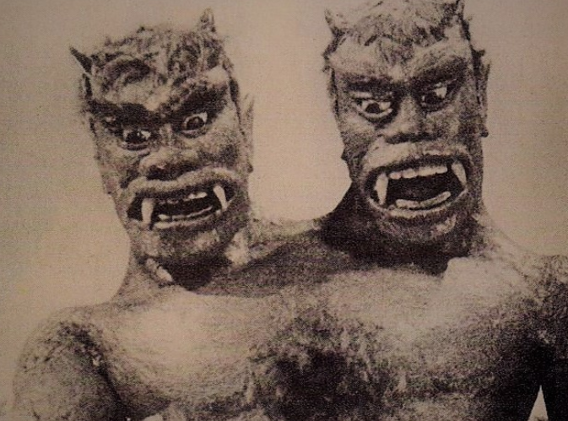
The CFPB and FTC

Slide 13
Rohit Chopra Hit List
Credit Margins
Junk Fees
Equity
Discrimination
Fair Lending

Slide 14
Rohit Chopra Hit List
Equity
Discrimination
May 2020 statement: “…today’s action marks the beginning of more date-driven detection of discrimination and a systemic approach to protecting Americans from auto market abuses.”

Slide 15
FTC Commissioner Rebecca Kelly Slaughter
“The automobile-financing market in the United States is profoundly broken.”
“On that score, dealer markup has got to go. And I would like to help.”
“The policy of permitting unfettered discretionary dealer markup leads to the same racist result, whether or not discriminatory intent is involved.”

Slide 16
In March 2022, the CFPB announced its intention to use its authority to prosecute discrimination as an unfair act or practice in any financial services category. This would include banking, servicing, collections, credit reporting, payments, or money transfers and remittances. Advertising, pricing, and other areas are targets for the Bureau to ensure that companies are appropriately testing for and eliminating illegal discrimination.

Slide 17
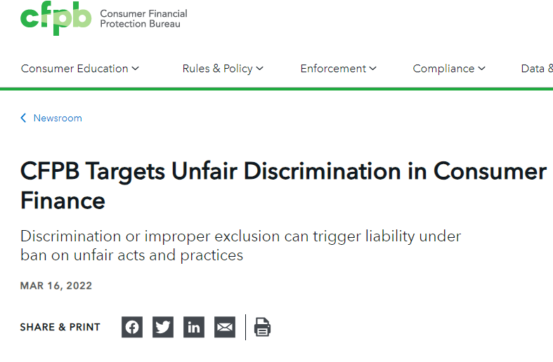
In March 2022, the CFPB announced its intention to use its authority to prosecute discrimination as an unfair act or practice in any financial services category. This would include banking, servicing, collections, credit reporting, payments, or money transfers and remittances. Advertising, pricing, and other areas are targets for the Bureau to ensure that companies are appropriately testing for and eliminating illegal discrimination.

Slide 18
CFPB’s Unfairness Test
The CFPB’s unfairness test is trifurcated:
(1) discrimination causes or is likely to cause substantial injury to consumers,
(2) such injuries are not reasonably avoidable by consumers, and
(3) those injuries are not outweighed by countervailing benefits to consumers or competition.
It’s the view of the Bureau that consumers may be unaware that they have been the subject of discrimination.

Slide 19
The CFPB’s Updated Unfair, Deceptive, or Abusive Acts or Practices (UDAAPs) Examination Manual
The Manual was updated to interpret unfairness as a tool to combat discrimination through the Bureau’s examination process. The Manual provides the explication of this expectation that organizations will respect the UDAAP standard and apply it ubiquitously throughout their business activities.
The examination process will track businesses to ensure that they are implementing the following:
Have processes to "prevent discrimination in relation to all aspects of consumer financial products or services." This would include their compliance programs with appraisals of their protocols to identity and combat discrimination.
Insure that business "… policies, procedures and practices do not target or exclude consumers from products and services, or offer different terms and conditions, in a discriminatory manner,"

Slide 20
The CFPB’s Updated Unfair, Deceptive, or Abusive Acts or Practices (UDAAPs) Examination Manual
CONTINUING
The examination process will track businesses to ensure that they are implementing the following:
"… [M]arketing or advertising does not improperly target or exclude consumers on a discriminatory basis, including through digital advertising,"
Customer service personnel will be trained to prevent discrimination.
Verification protocols will apply to "…employees and third parties who market or promote products or services [who] are adequately trained so that they do not engage in unfair, deceptive, or abusive acts or practices, including discrimination."

Slide 21
The CFPB’s Updated Unfair, Deceptive, or Abusive Acts or Practices (UDAAPs) Examination Manual
CFPB examiners will require supervised companies to demonstrate their processes for assessing risks and discriminatory outcomes, including documentation of customer demographics and the impact of products and fees on different demographic groups.
The CFPB is careful to note that injuries sustained from discrimination do not need to be intentional. Machine learning models and artificial intelligence will be a point of focus for “any potential discriminatory outcomes.” Disparate impact will be a preferred theory for UDAAP analysis.

Slide 22
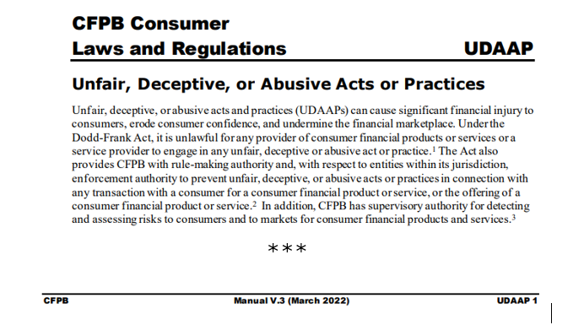
The CFPB Audit Manual

Slide 23
Legal Challenges: Government Action
Past is Prologue
Prosecuting Discrimination

Slide 24
The FTC
In the Matter of Liberty Chevrolet, Inc. d/b/a Bronx Honda
ALLEGATIONS
Race Discrimination in Financing Terms.
used derogatory terms to refer to minority customers.
defendants instructed their sales personnel to charge higher markups and additional fees to African-American and Hispanic customers
Deceptive Advertising.
Unauthorized Charges on Certified Pre-owned Cars. Various Deceptive Fees.
Truth in Lending Act advertising violations. $1,500,000 Settlement

Slide 25
FTC Enforcement Against Dealers
FEDERAL TRADE COMMISSION and PEOPLE OF THE STATE OF ILLINOIS, Plaintiffs, v. NORTH AMERICAN AUTOMOTIVE SERVICES, INC., also d/b/a Ed Napleton Automotive Group, et al
FTC and State of Illinois allege dealer group included illegal junk fees for unwanted “add-ons” onto customers’ bills and for discriminating against black consumers by charging them more for financing
$10 million penalty
sneak junk fees for add-on products and services into consumers’ purchase contracts
These junk fees were often added despite consumers specifically declining the add-ons or having confirmed prices that did not include the add-ons.
consumers were falsely told the add-ons were free or were a requirement to purchase or finance their vehicle.
83 percent of buyers from the dealerships were charged junk fees for add-ons
discriminated against black consumers in connection with financing vehicle purchases.
Black customers were charged approximately $190 more in interest and paid $99 more for similar add-ons than similarly situated non-Latino White customers.

Slide 26
Federal Trade Commission v. Passport Automotive Group - October 18, 2022
Violations of the FTC Act and the Equal Credit Opportunity Act (ECOA).
Defendants are dealerships located in Maryland and Virginia, the owner and President, and the Vice President of the dealerships, doing business as the Passport Automotive Group. In order to settle the lawsuit, the
Defendants will pay the FTC $3.3 million, which the FTC will use to refund to Passport consumers as well as
Defendants shall implement a “Fair Lending Program”
Defendants shall charge no financing retail margin (markup) or charge the same retail margin rate to all consumers, not to exceed 100 basis points on all non-subvented retail installment sales contracts.
Various allegations were made including deceptive advertising, pricing, and double charging.

Slide 27
Federal Trade Commission v. Passport Automotive Group - October 18, 2022
In addition, the defendant is alleged to unlawfully discriminate on the basis of race, color, and national origin by imposing higher costs on Black and Latino consumers, on average, than non-Latino White consumers.
Defendants are permanently restrained and enjoined from misrepresenting advertising, pricing, and financing terms.
Defendants are permanently restrained and enjoined from:
Discriminating against any credit applicant on the basis of race, color, religion, national origin, sex or marital status, or age (provided the applicant has the capacity to contract), because all or part of the applicant’s income derives from any public assistance program, or because the applicant has in good faith exercised any right under the Consumer Credit Protection Act.

Slide 28
Federal Trade Commission v. Passport Automotive Group - October 18, 2022
Defendants must establish, implement, and maintain a “Fair Lending Program” that safeguards against discrimination. At a minimum, Defendants must:
Designate a finance director or manager qualified in fair lending compliance and responsible for the dealership’s “Fair Lending Program.”
Ensure that all employees, before engaging in the extension, renewal, or continuation of credit, will receive training at least every 12 months from an independent qualified person regarding the “Fair Lending Program,” the Equal Credit Opportunity Act (ECOA), and sign an acknowledgement of training and an understanding of their legal responsibilities under the federal fair lending laws.
Implement and maintain written guidelines specifying the reasons for assessing or not assessing any fee or charge.

Slide 29
Contemporary Cases and Initiatives
FTC v. Tate's Auto Center of Winslow, Inc., 2021 U.S. Dist. LEXIS 23088 (D. Ariz. February 5, 2021).
Applications with Inflated Income in Violation of the FTC Act
Advertising violations
Individual Liability for Violations of the FTC Act.

Slide 30
Fair Lending Defined

Slide 31
Fair Lending Defined
Dodd-Frank Act definition:
Fair lending means "fair, equitable, and nondiscriminatory access to credit for consumers."

Slide 32
Scope of Fair Lending Laws
Fair lending laws
All credit products and services for both consumer and business purposes;
Entire loan life cycle, including collections and servicing.

Slide 33
Fair Lending – Three Legal Theories of Discrimination
Overt Discrimination
Disparate Treatment
Disparate Impact

Slide 34
Fair Lending - Overt Discrimination
Direct evidence that lender intentionally discriminated on prohibited basis or expressed discriminatory preference, even without acting on that preference.

Slide 35
Fair Lending - Disparate Treatment
Circumstantial evidence that lender intentionally treated similarly situation persons differently on prohibited basis.
Even if not motivated by prejudice or conscious intent to discriminate, differences in treatment are considered "intentional" if no credible, explainable policy or practice can be determined.

Slide 36
Fair Lending - Disparate Impact
Evidence that lender applied neutral policy or practice uniformly to all credit applicants, but the policy or practice has a disproportionately adverse impact on members of protected class group without proper business justification.

Slide 37
Fair Lending - Disparate Impact

Slide 38
Thomas Bayes and Bayesian Analysis
In the early part of the eighteenth century, Thomas Bayes, a mathematician and statistician, devised this involved formula. The application of Bayes theorem is Bayesian Analysis. His formula is based upon statistics and attempts to predict results, a truly daunting objective.
In 2000, Bayes theorem was modified by the Rand Corporation, and produced Bayesian Improved Surname Geocode (BISG). to help determine whether minorities were receiving healthcare at the same rate as whites. BISG wasn’t intended for use in fair lending analysis or to demonstrate disparate impact. Subsequently, BISG was adopted by the federal and state government for their prosecutions.
The modern version of the theorem is referred to as the proxy method.

Slide 39
The Laws Addressing Fair Lending
Two primary federal laws govern fair lending practices:
Equal Credit Opportunity Act ("ECOA")
ECOA, enacted in 1974, prohibits discrimination based on race, color, religion, national origin, sex, marital status, age, source of income, or whether person exercises rights granted under Consumer Credit Protection Act for any aspect of consumer or business credit transaction

Slide 40
ECOA - Anti-Discrimination Requirements
ECOA prohibits discrimination in any aspect of a credit transaction:
Applies to any extension of credit, whether consumer or business, including extension of credit to small businesses, corporations, partnerships and trusts, and across loan's life cycle.
ECOA also prohibits discouraging application, which may impede access to credit.

Slide 41
The Laws Addressing Fair Lending
The second of the two primary federal laws govern fair lending practices:
Fair Housing Act ("FHA") and HUD Regulations (Part of Civil Rights Act of 1968)
Unlawful for any lender to discriminate in "residential real estate-related transaction" against any person because of his race, color, religion, national origin, sex, familial status, or handicap.
State or local laws may include additional prohibited bases

Slide 42
Unfair, Deceptive, or Abusive Acts or Practices (UDAAP)
Section 5 of the Federal Trade Commission Act (FTC Act) (15 USC 45) prohibits ''unfair or deceptive acts or practices in or affecting commerce.'' The prohibition applies to all persons engaged in commerce, including banks and dealers.

Slide 43
Unfair, Deceptive, or Abusive Acts or Practices (UDAAP)
“..an act or practice is unfair if it “causes or is likely to cause substantial injury to consumers … which is not reasonably avoidable by consumers themselves and not outweighed by countervailing benefits to consumers …”
Federal Trade Commission v. Passport Automotive Group - October 18, 2022

Slide 44
In the Passport case, FTC Chairman Lina Khan, and Commissioners Slaughter and Bedoya, state in their joint opinion:
“[The alleged discriminatory imposition of higher borrowing costs to minorities] …is a straightforward application of Section 5. Section 5(n) of the FTC Act states that an act or practice is unfair if it “causes or is likely to cause substantial injury to consumers or competition which is not reasonably avoidable by consumers themselves and not outweighed by countervailing benefits to consumers or competition.”
***
The fact that harmful conduct may be subject to other legal or regulatory regimes does not in itself limit (or lessen) the FTC’s responsibility to use all of our available authorities to target such conduct. Where Congress passes laws prohibiting conduct that also violates the FTC Act, the FTC often charges violators with the full range of law violations, including Section 5. Section 5 does not wilt when Congress legislates (emphasis added).”

Slide 45
Other federal laws that relate to fair lending:
Community Reinvestment Act ("CRA") (12 USC 2901 et. Seq.):
CRA and Regulation BB encourage financial institutions to meet credit needs of communities they serve. A poor "fair lending" record can negatively affect CRA rating and result in denial of applications to open branch, relocate office, or acquire another financial institution.
Could it be applied to the car business?
Redlining and Reverse Redlining

Slide 46
Fair Lending - Disparate Impact
A plaintiff must:
Identify the specific policy or practice of the defendant;
Establish a disparate impact through the use of statistical evidence; and
Prove the existence of a causal link between the identified policy and the disparate impact.

Slide 47
Relationship between UDAAP and Fair Lending
UDAAP is the most powerful tool in CFPB arsenal: Almost ANY practice can be attacked under broad UDAAP standards applied by CFPB.
Fair lending as powerful alternative: "Disparate impact" analysis, despite its questionable legal footing under ECOA/FHA, may be used to attack practices that, while not violating UDAAP, have a disparate impact on protected classes.

Slide 48
UDAAP: Vagueness Concerns - Defined Case-By-Case
"The possibilities here for injuring consumers are almost limitless. Maybe a customer service representative provided misleading information. Maybe consumers were told only about the benefits of a product and not about any of the limitations or risky features. Maybe important information about rates or fees was hidden or obscured. Or maybe consumers were told that they would have the chance to consider the matter further, and later found they were already signed up and charged for a service without ever giving their actual consent."
CFPB Director Richard Cordray, Feb. 21, 2013

Slide 49
UDAAP "Unfairness" Standard
Causes, or likely to cause, substantial injury to consumers;
The injury is not reasonably avoidable by consumers; and
The injury is not outweighed by countervailing benefits to consumers or to competition.

Slide 50
UDAAP "Unfairness" Standard - Important Considerations from CFPB
When determining monetary harm, consider that an act or practice that causes a small amount of harm to a large number of people may be deemed to cause substantial injury.
Actual injury not required; significant risk of concrete harm is sufficient.

Slide 51
UDAAP "Deceptive" Standard
The representation, omission, act or practice misleads or is likely to mislead the consumer;
The consumer's interpretation of the representation, omission, act or practice is reasonable under the circumstances; and
The misleading representation, omission, act or practice is material.

Slide 52
UDAAP "Abusive" Standard
Materially interferes with the ability of a consumer to understand a term or condition of a consumer financial product or service; or
Takes unreasonable advantage of:
A lack of understanding on the part of the consumer of the material risks, costs, or conditions of the product or service;
The inability of the consumer to protect its interests in selecting or using a consumer financial product or service.

Slide 53
Be Afraid, Be Very Afraid – Federal Regulators’ Timeline
On January 18, Federal Trade Commission issued an advisory opinion addressing the Holder Rule's impact on consumers' ability to recover attorneys' fees and costs.
On February 24, in response to the increasing cost of automobiles and the potential for consumer debt related to vehicle financing to increase, the Consumer Financial Protection Bureau issued a blog post stating its intent to "focus on ensuring a fair, transparent, and competitive auto lending market."
On March 16, the Consumer Financial Protection Bureau announced that it updated its examination procedures for evaluating unfair, deceptive, or abusive acts or practices to address discriminatory practices in connection with consumer financial products or services.
On March 22, the Consumer Financial Protection Bureau issued Compliance Bulletin 2022-05: Unfair and Deceptive Acts or Practices that Impede Consumer Reviews

Slide 54
Be Afraid, Be Very Afraid – Federal Regulators’ Timeline
On May 6, the Consumer Financial Protection Bureau released its annual fair lending report to Congress highlighting the agency's supervision, enforcement, guidance and rulemaking, and other efforts last year to ensure fair, equitable, and nondiscriminatory access to credit by consumers.
On May 16, the Consumer Financial Protection Bureau announced that it will issue Consumer Financial Protection Circulars to federal and state government agencies that are responsible for enforcing federal consumer financial law.
On May 19, the Consumer Financial Protection Bureau issued an interpretive rule affirming the states' ability to enforce the Consumer Financial Protection Act of 2010, including a provision that makes it unlawful for covered persons or service providers to violate federal consumer financial protection laws.

Slide 55
Be Afraid, Be Very Afraid – Federal Regulators’ Timeline
On June 23, the Federal Trade Commission released a notice of proposed rulemaking to address unfair and deceptive conduct by motor vehicle dealers in connection with the advertising, sale, financing, and leasing of vehicles
On June 3, the Federal Trade Commission requested public comment on its business guidance document concerning digital advertising: ".com Disclosures - How to Make Effective Disclosures in Digital Advertising.“
On June 23, the Federal Trade Commission released a notice of proposed rulemaking to address unfair and deceptive conduct by motor vehicle dealers in connection with the advertising, sale, financing, and leasing of vehicles

Slide 56
Be Afraid, Be Very Afraid – Federal Regulators’ Timeline
On July 29, the Department of Justice and the Consumer Financial Protection Bureau issued a joint notification letter reminding auto-secured creditors and leasing companies of their responsibilities to recognize important legal protections for military families under the Service Members Civil Relief Act.
On August 11, the Consumer Financial Protection Bureau issued Circular 2022-04 to confirm that financial companies can violate the prohibition on unfair acts or practices in the Consumer Financial Protection Act when they have insufficient data protection or information security. According to the circular, "[i]n addition to other federal laws governing data security for financial institutions, including the Safeguards Rules issued under the Gramm-Leach-Bliley Act, 'covered persons' and 'service providers' must comply with the prohibition on unfair acts or practices in the CFPA.

Slide 57
A Related
Banker’s View:
Fair Lending

Slide 58
A Related Banker’s View
Focus was on Disparate Impact
Discrimination is alleged when policies, practices, rules or other systems that, appear to be neutral, result in a disproportionate adverse impact on a protected class of consumers.
Dealer markups are not expressly prohibited but the CFPB has sought to render enforcement against institutions in order to hamper the use (until 2018 guidance was nullified by joint resolution of Congress).

Slide 59
A Related Banker’s View
Why Do Banks Analyze Data?
Part of a robust Compliance/Ethics/ ESG Program (Environmental, Social, and Corporate Governance)
It’s good for business (allegedly).

Slide 60
A Related Banker’s View
Bronx Honda
Discriminatory practices could be pursed using UDAAP
Bostock v. Clayton County, June 2020, is a landmark United States Supreme Court civil rights case in which the Court held that Title VII of the Civil Rights Act of 1964 protects employees against discrimination because they are gay or transgender. An executive order followed.
Therefore, ECOA includes sexual orientation and gender identity discrimination.
New Protected Classes – LGBT Statistics
Extensive data and record analysis of all discrete and insular minority groups (protected classes) utilizing numerous statistical protocols

Slide 61
Recommendations and Comments

Slide 62
Dealer Participation, Voluntary Protection Products and the Safeguards Rule

Slide 64
Something worth doing is worth doing poorly.

Slide 65
The FTC and Sugared Cereal and other Similar Products
History repeats itself, first as tragedy, second as farce.
Karl Marx

Slide 66
Predictions of the Future

Slide 67
“Prediction is very difficult, especially if it's about the future!”
Niels Bohr, Nobel Laureate in Physics and the father of the atomic model

